Slide 1
Lecture # 02
Computer Graphics
Dr. Rashed Mustafa
B.Sc. (Engg.) , SUST, M.Phil (CU), Ph.D. (SIAT, China)
Professor
Computer Science and Engineering
University of Chittagong

Slide 2
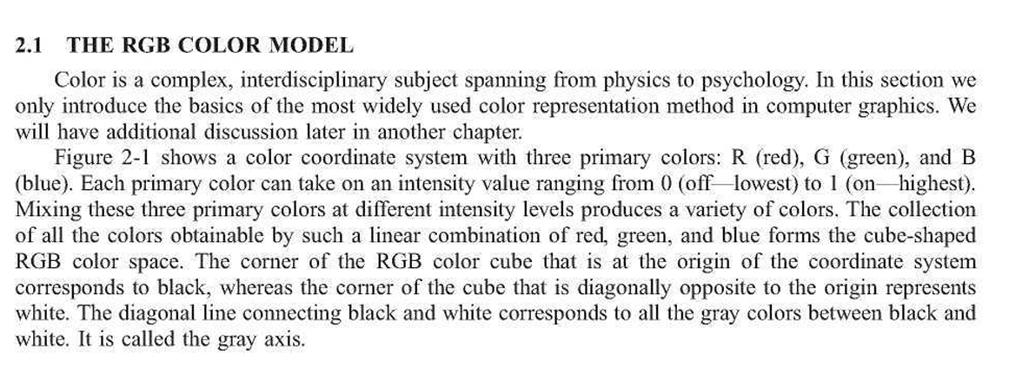
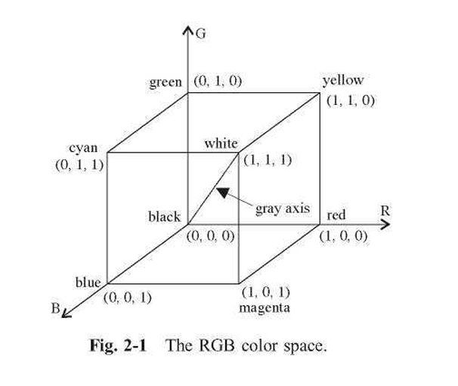
RGB color model

Slide 3
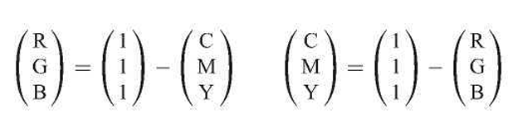
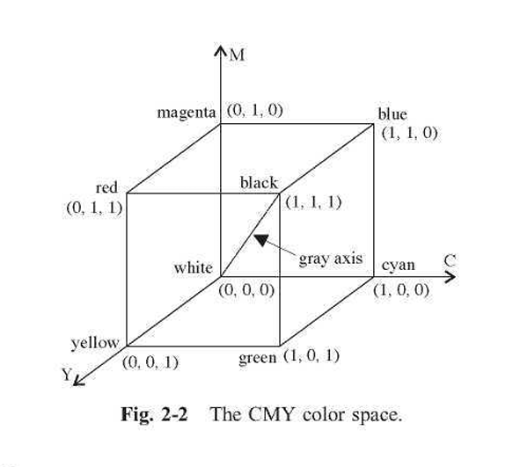
CMY Color Model

Slide 4

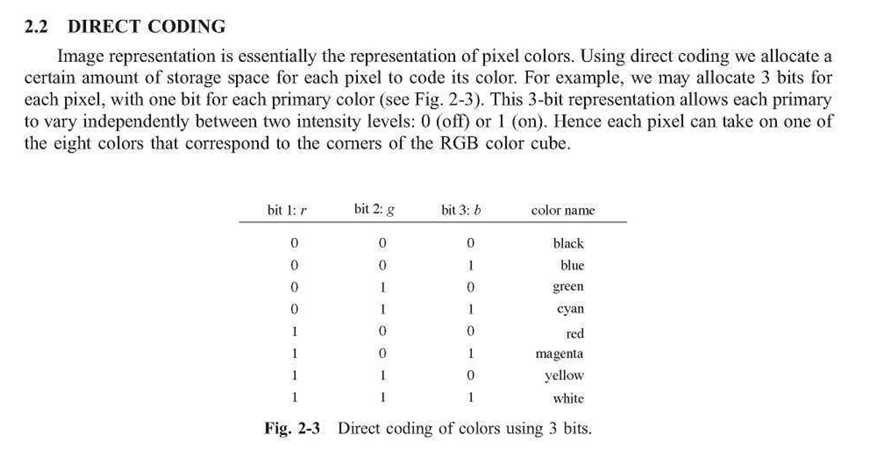
Color coding

Slide 5
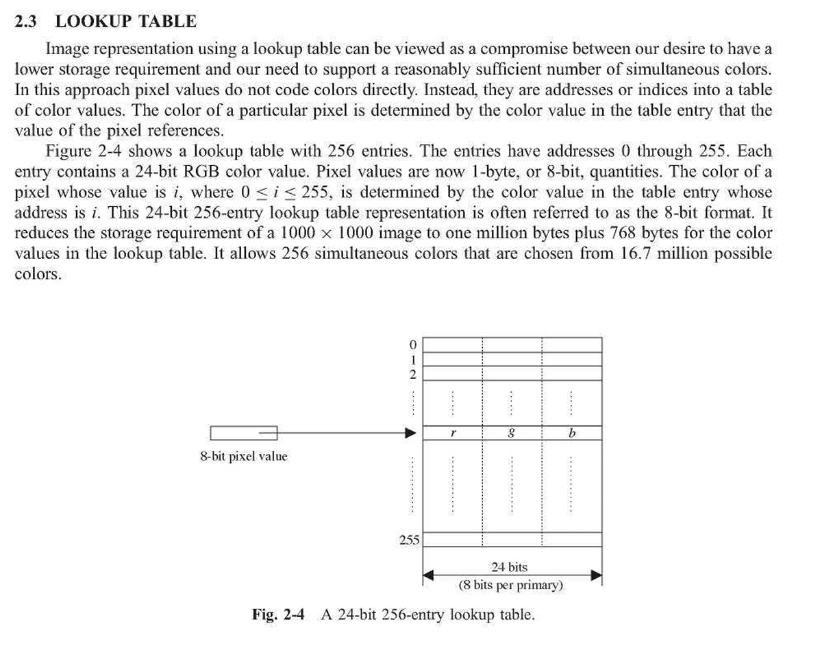
Lookup table

Slide 6
Comparison Between CRT, LCD, PDP, and OLED Monitors
Monitors are essential in daily life, from phones to medical devices.
CRT was one of the earliest display technologies.
New technologies: LCD, PDP, OLED.
Objective: Compare working principles, advantages, disadvantages, applications, and trends.

Slide 7
CRT Overview
Uses electron beams to excite phosphor-coated screens.
Advantages: Low cost, short response time, high color accuracy, wide viewing angle.
Disadvantages: Large size, high power consumption, radiation.
Applications: Specialized industries like metallurgy, medicine, and vision research.

Slide 8
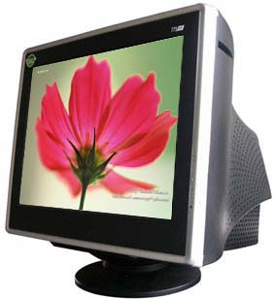
CRT MONITOR cathode-ray tube

Slide 9
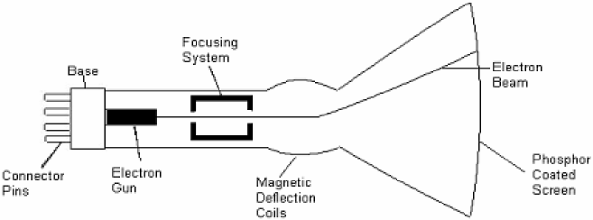
How CRTs work & display?
A CRT monitor contains millions of tiny red, green, and blue phosphor dots that glow when struck by an electron beam that travels across the screen to create a visible image.
In a CRT monitor tube, the cathode is a heated filament. The heated filament is in a vacuum created inside a glass tube. The electrons are negative and the screen gives a positive charge so the screen glows.

Slide 10
LCD Overview
Works with liquid crystal layers and backlight.
Advantages: Thin, lightweight, low power consumption, no radiation, long lifespan.
Disadvantages: Narrower viewing angle, poor black color reproduction, rigid structure.
Applications: TVs, monitors, smartphones, and instrument panels.

Slide 11
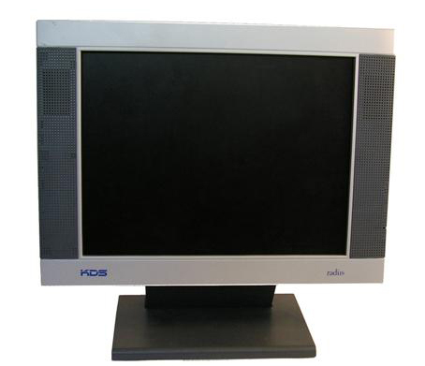
LCD
Liquid Crystal Display

Slide 12
How does it work & display
Liquid crystal displays work by the tiny pixels on the screen showing more than 20,000,000 colours an LCD screen is a multilayered, sideways sandwich.
A fluorescent light source, known as the backlight. This light passes through the first of two polarizing filters. The polarized light then passes through a layer that contains thousands of liquid crystal pixels arrayed in tiny containers called cells.
The cells are, in turn, arrayed in rows across the screen; one or more cells make up one pixel.
Electric leads around the edge of the LCD create an electric field that twists the crystal molecule, which lines the light up with the second polarizing filter and allows it to pass through it.

Slide 13
Advantages of LCD
The sharpness of a LCD display is at maximum tweakness.
Zero geometric distortion at the native resolution of the panel.
High peak intensity produces very bright images. Best for brightly lit environments.
Screens are perfectly flat.
Thin, with a small footprint. Consume little electricity and produce little heat
The LCD display unit is very light and can be put anywhere or moved anywhere in the house.
Lack of flicker and low glare reduce eyestrain.

Slide 14
Disadvantages of LCD
After a while the LCD display the some of the pixels will die you will see a discoloured spot on a black spot on the display.
The cost of a LCD is considerably at a high price.
The LCD display will have slow response times.
The LCD display has a fixed resolution display and cannot be changed.
LCDs use analog interface making careful adjustment of pixel tracking/phase in order to reduce or eliminate digital noise in the image.
The viewing angle of a LCD display is very limited due to the Automatic pixel tracking/phase controls.

Slide 15
PDP Overview
Uses plasma discharge with inert gases to produce light.
Advantages: High brightness, good color reproduction, wide viewing angle, no geometric distortion.
Disadvantages: High power consumption, heat generation, expensive.
Applications: Large public displays, high-definition TVs.

Slide 16
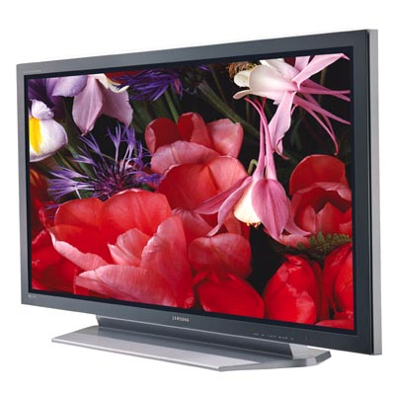
Plasma

Slide 17
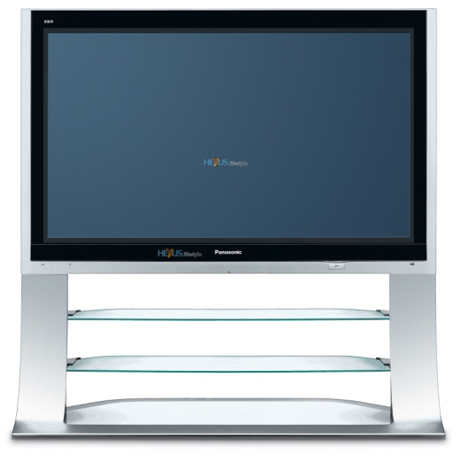
How does it work & display
The television lights up thousands of tiny dots with a high-energy beam of electrons. In most systems, there are three pixel colours -- red, green and blue which are evenly distributed on the screen.
By combining these colours in different proportions, the television can produce the entire colour spectrum. The phosphors on the screen of the plasma enhances the viewing pleasure

Slide 18
Advantages of plasma
Larger viewing angle, 160º compared to LCD 40º & rear projection 120º. (Allows a larger audience to be able to view the image reproduction)
No projection throw distance limitations.
All plasma display units are considerably thinner in width than the cathode ray tube monitors.
Most plasma display units are either free standing or can be mounted on a ceiling or wall.
The plasma display units has a clearer image, brighter viewing angle, better colour quality and higher contrast ratio than the CRT and LCD display units.

Slide 19
Disadvantages of plasma
Compared to other display units the plasma display unit has a very short life span, the manufactures estimate the life span to be around 20,000 hours to 30,000 hours (at a rate of 4 hours of TV a day that gives only 13.7 years).
As your plasma display unit gets older its brightness gets dimmer.
Plasma display units are considerably more expensive than cathode ray tube monitors.
Plasma display units must be handled carefully because they are a very easily broken display unit.

Slide 20
OLED Overview
Uses organic compounds that emit light when current passes.
Advantages: High contrast, vivid colors, flexible screens, energy-efficient for dark images.
Disadvantages: Shorter lifespan, costly production, sensitive to moisture.
Applications: Smartphones, TVs, wearables.

Slide 21
Organic Light Emitting Diode
Both OLED and LED use the same principle of electroluminescence- the optical and electrical phenomenon where certain materials emit light in response to an electric current passing through it.
OLED
  Lighter weight
  Perform at lower efficiencies
  Less power consumption
  Organic based chemicals

Slide 22
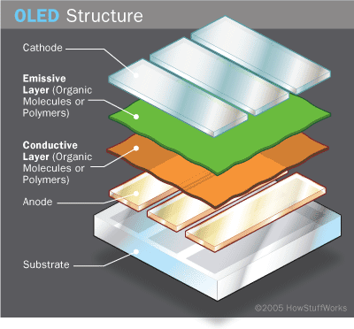
How It Works
Composed of two substrate layers on the outside
Emissive and conductive layer lie between the cathode and the anode layers
A current is applied across the LED, where electrons move from cathode to anode
The cathode gives electrons to the emissive layer, where the anode withdraws these electrons from the conductive layer
The emissive layer becomes rich in negative charge while the conductive layer becomes more positively charged
The two charges recombine in the emissive layer, creating a drop in energy levels of the electrons
The drop in energy levels results in radiation that is on the visible spectrum, emitting light

Slide 23
Advantages
  Brighter, clearer picture
  More efficient viewing angle
  Thinner, lighter in weight
  Low powered
  Can be printed on various surfaces
Disadvantages
  Short term battery life
  Expense
  Doesn’t like water

Slide 24
Comparative Analysis
CRT: Bulky, high power use, wide viewing angle, high color quality, no flexibility.
LCD: Thin/light, low power use, medium viewing angle, good color quality, no flexibility.
PDP: Thin/light, high power use, wide viewing angle, excellent color quality, no flexibility.
OLED: Ultra-thin, low/medium power use, wide viewing angle, excellent color quality, flexible.

Slide 25
Future Trends
Displays moving toward: Energy saving, low cost, lightweight, thin design.
Potential material: Graphene for advanced displays.
Coexistence of multiple technologies due to unique strengths.

Slide 26
Conclusion
CRT largely replaced but still needed in some fields.
LCD dominates mainstream market.
PDP excels in large-scale displays.
OLED leading in mobile devices and flexible designs.
Future: Search for near-perfect materials to combine best features.

Slide 27

Thank You

